Slide 1


Ternary Conditions

Slide 2
Lecture CheckList
Introduction to ternary operator.
Why majority of developers use the ternary operator?
Syntax of Ternary operator.
Code Implementation.
Chaining using the Ternary operator.

Slide 3
Introduction to ternary operator.
Operators are used to assign, compare, and evaluate one, two, or more operands. We have different types of operators in JavaScript. These include comparison, arithmetic, logic, ternary, etc. Ternary operators have 3 blocks and are often used as a shorthand for an if-else statement.

Slide 4
Why majority of developers use the ternary operator?
The majority of developers use the ternary operator because:
The ternary operator allows you to write simple if-else statements in a single line of code, making your code more compact and readable.
The ternary operator can make your code more expressive by allowing you to clearly express the intent of the code in a single line.
The ternary operator is simple to use and understand, making it a good choice for short and simple conditions.
The ternary operator is widely used in several libraries and frameworks such as React.js where it's widely used.

Slide 5
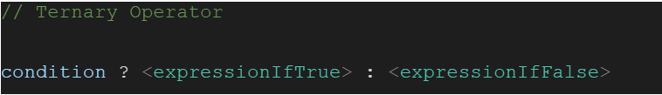
Syntax of Ternary Operator:

Slide 6
Code Implementation.
Let’s look at an example. Assume that you need to check if the person is logged in or not and provide the access to PW Skills lab.
We can do this in either of the ways:
Using if-else statements.
Using the ternary operator.

Slide 7
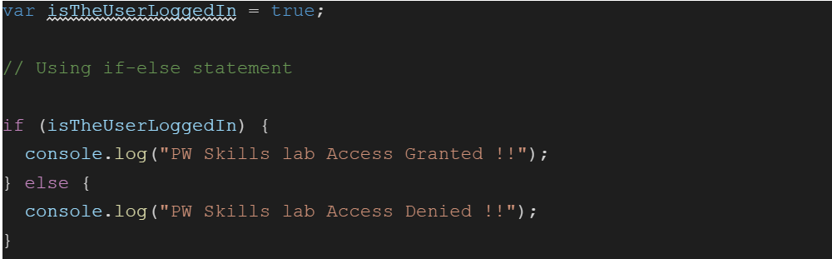
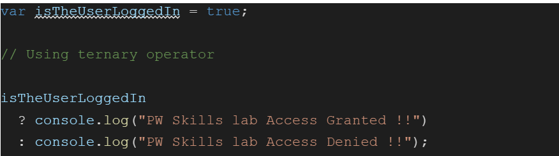
Code Implementation.

Slide 8
Chaining using the Ternary operator.
Let’s assume in order to access the “Full Stack Web Developer Course”, the user must be both logged in and should have purchased the course. Let’s see how can we do this using the ternary operator.

Slide 9
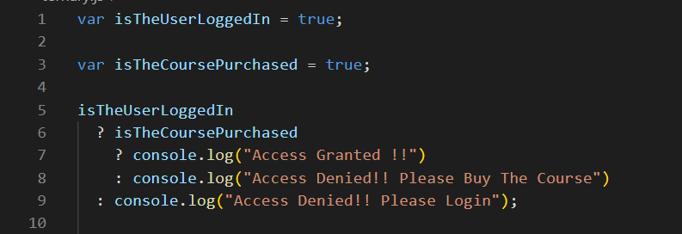
LIVE CODING: Should not be displayed
Notes:
It is not advised to use chaining in ternary operators as they are not readable and debugging would be complex.

Slide 10
THANK YOU

